Slide 1
MAVERICK BANK
TRAINEE NAME: Harshvardhan Magdum
TRAINER NAME: Madhu Kalla

Slide 2
About Maverick Bank
The Maverick Bank is a Banking and Financial System is a comprehensive application designed to manage the financial transactions and accounts of customers in a banking. This system caters to both individual and business customers, offering services such as account management, funds transfer, loans, investments, and financial reporting.
The system includes role-based dashboards for customers, executive, manager.

Slide 3
Key Features
JWT-based login & authentication. Also SignIn with google and Git Hub Option.
Role-based dashboards: Customer, Executive, Manager.
Junit testing is Implemented.
Created Docker for frontend, backend, and database created.
Customer registration and profile update.
Profile view and update for customers.
Open new bank account (select type,
branch, balance).
View all customer accounts with delete option (for Executive).
Loan application with status: PENDING /
APPROVED / REJECTED
Loan review & status update by bank employee
Transaction listing by account number
Form validations using React template-driven forms and reactive forms.
Routing,HTML,CSS,JS
Responsive UI using Bootstrap.
Component-based structure for easy maintenance.

Slide 4
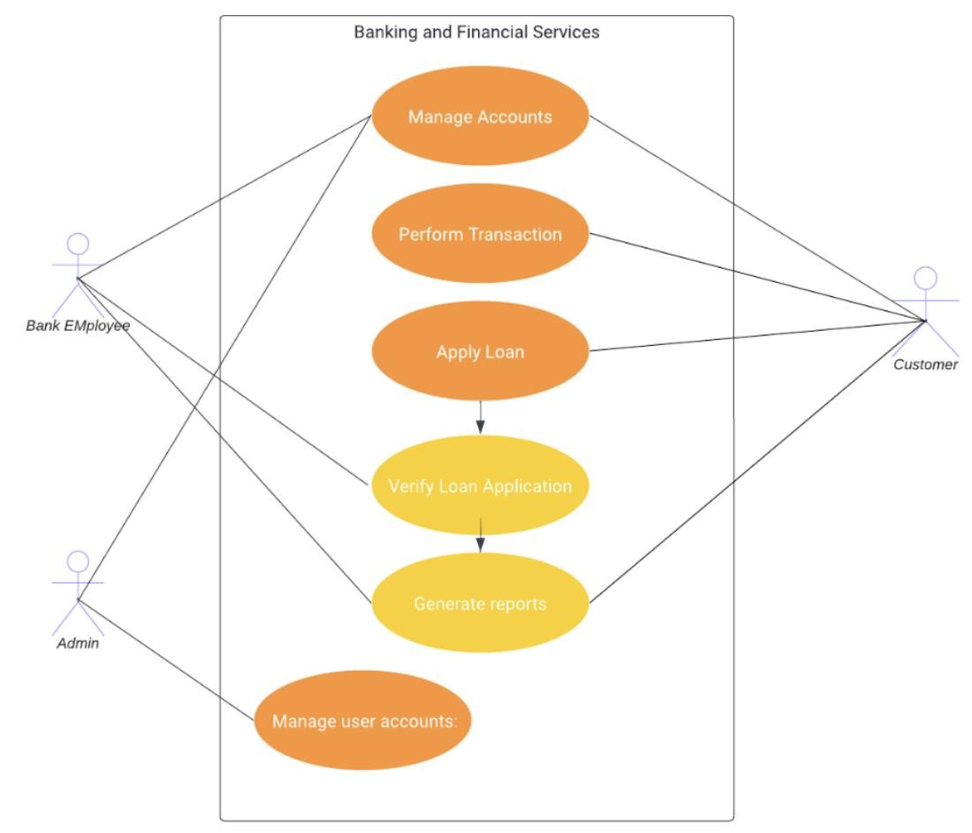
USE CASE DIAGRAM:
Executive
Customer
Manager

Slide 5
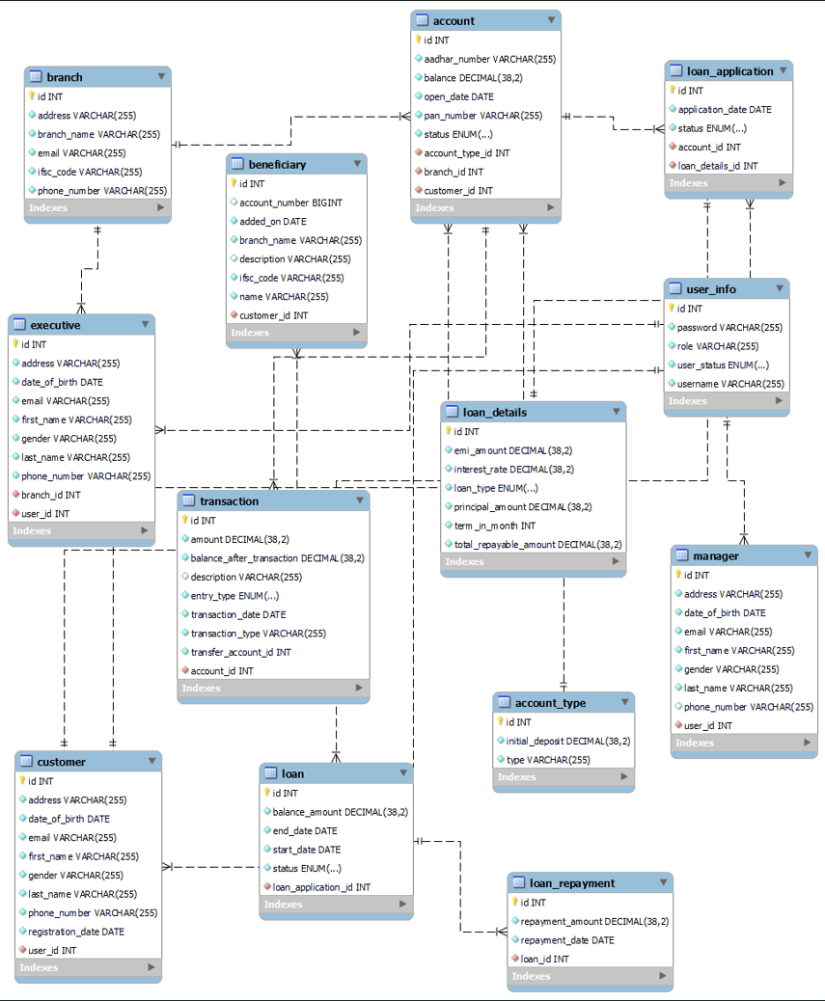
ER Diagram

Slide 6
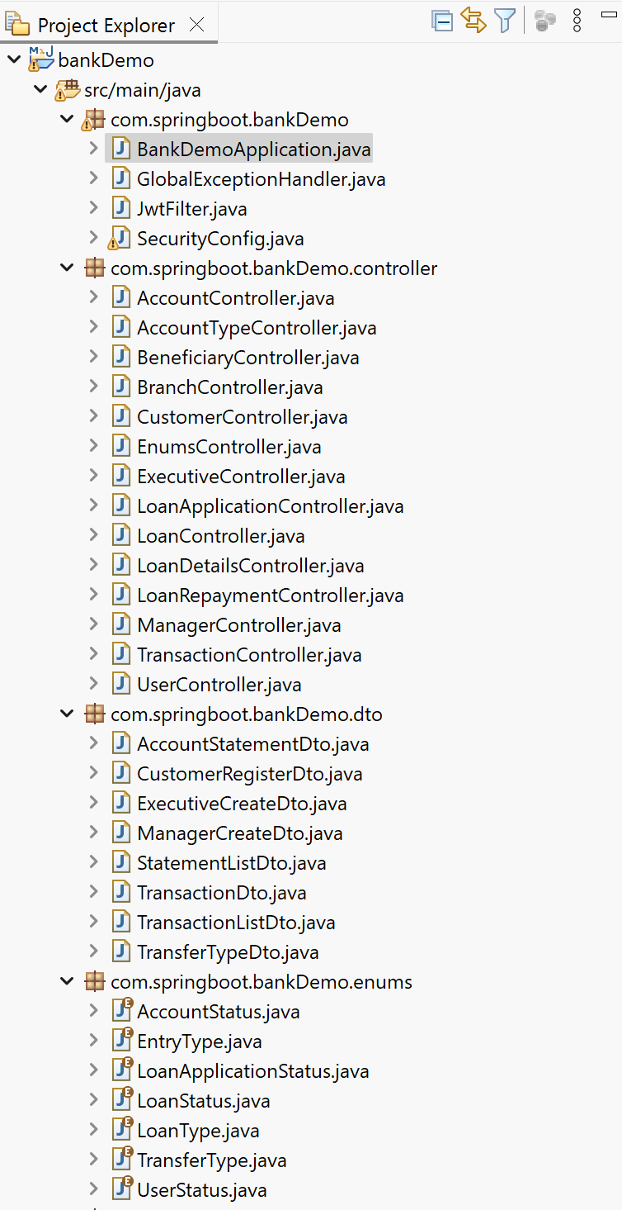
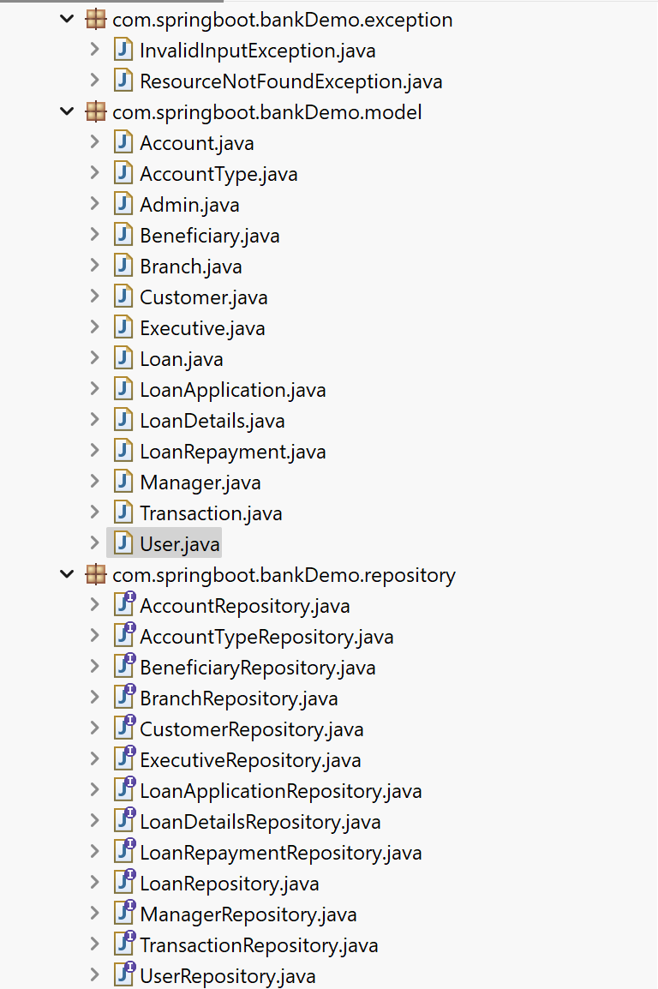
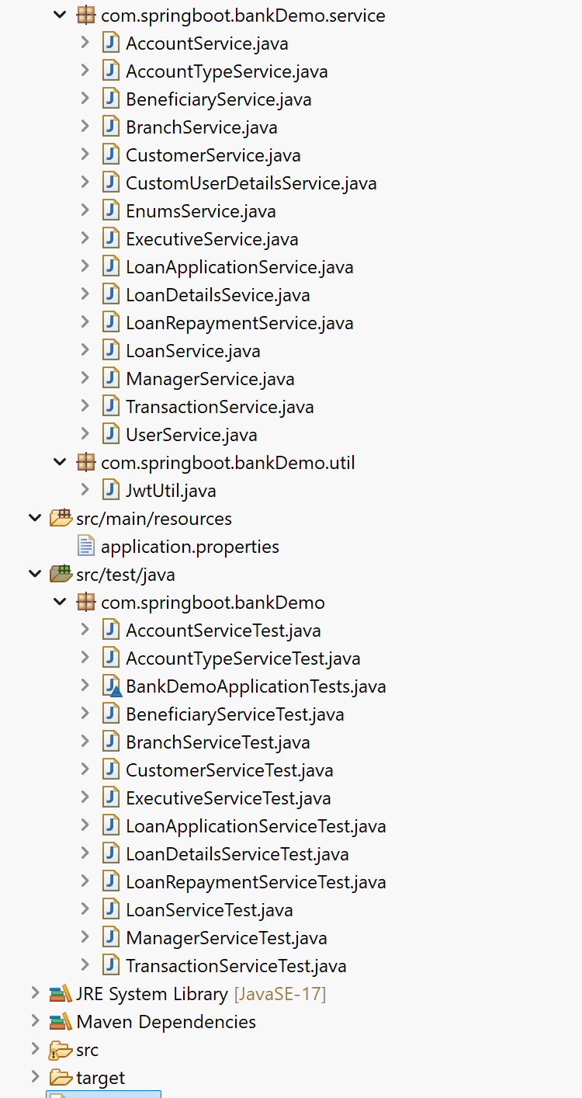
Backend Project Structure

Slide 7
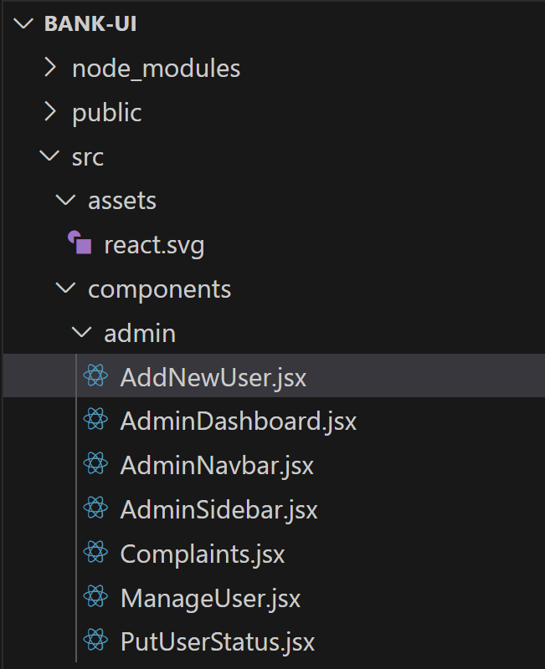
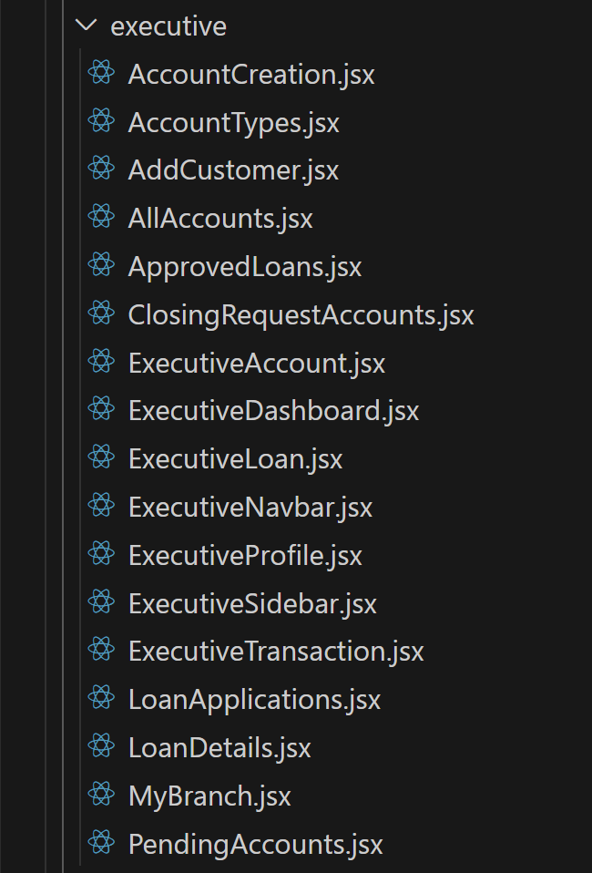
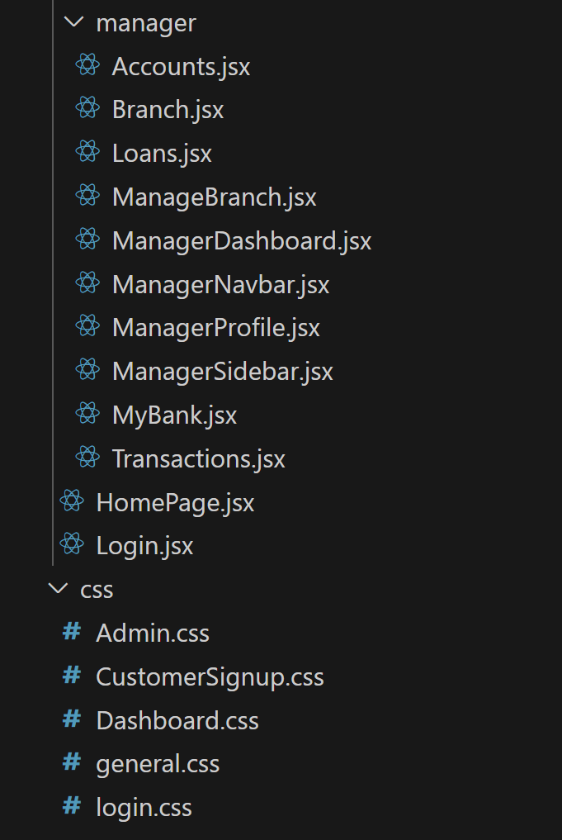
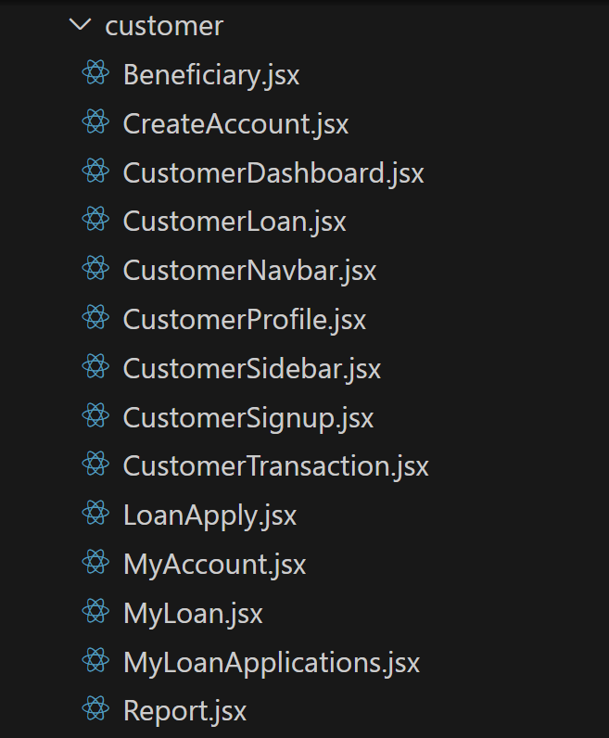
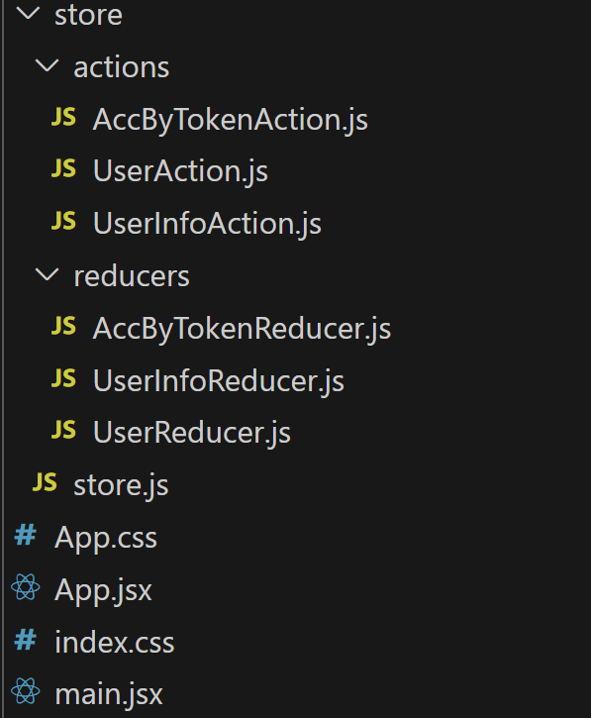
Frontend Project Structure

Slide 8
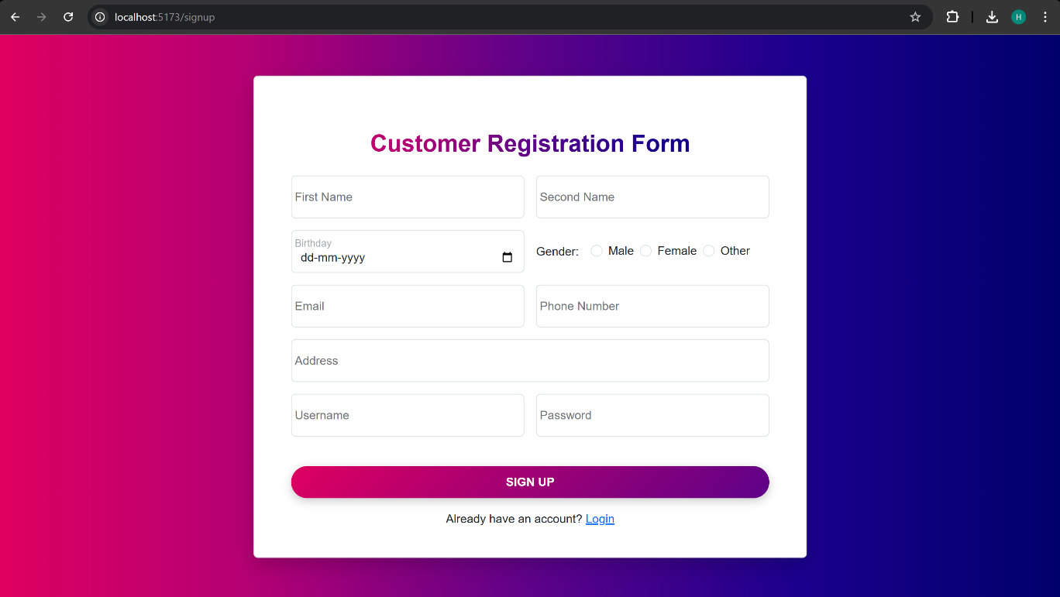
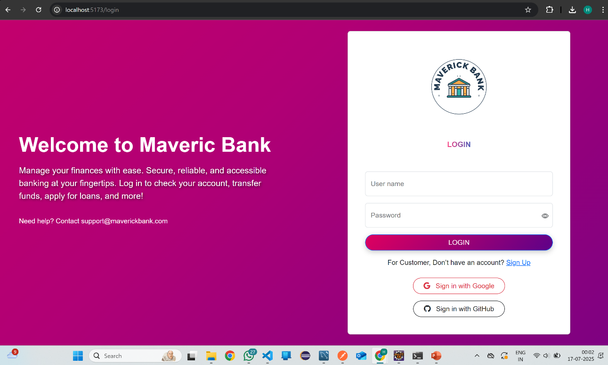
SCREENSHOTS
REGISTRATION PAGE:
LOGIN PAGE:

Slide 9
Technologies Used
Frontend: React, Bootstrap
Backend: Spring Boot, Spring Security, JWT
Database: MySQL
Tools: Postman, GitHub, VS Code,

Slide 10
Conclusion
Maverick Bank demonstrates full-stack development skills using modern frameworks and practices.
It is designed to be scalable, secure, and modular, making it suitable for real-world banking workflows.

Slide 11
Thank you
Harshvardhan Magdum
magdumharshvardhan1008@gmail.com
https://github.com/HarshvardhanMagdum/MaverickBank.git

